Slide 1
Thitawat Asaves
Executive Vice President,
Head of Investment Banking Division,
Bank of Ayudhya PCL.

Slide 2
Bank of Ayudhya
Investment Banking Group
ANNUAL GLOBAL FORUM 2018 - HUMAN SETTLEMENTS
FINANCING SUSTAINABLE URBAN INFRASTRUCTURE
UNCC Thailand

Slide 3
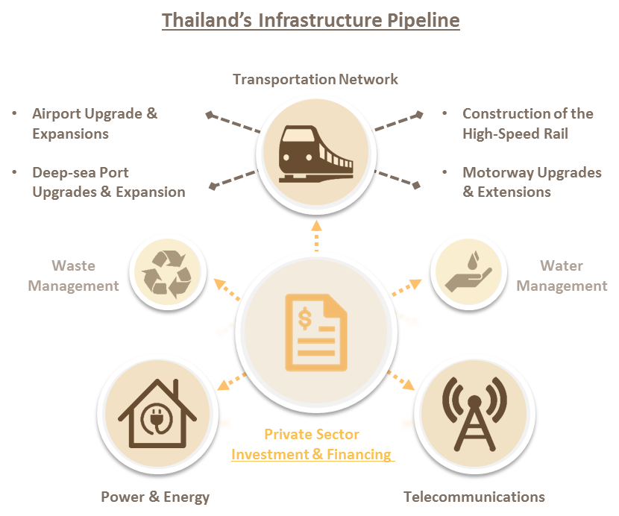
Financing Sustainable Urban Infrastructure
General Overview – Infrastructure Projects in Thailand
Infrastructure Background
Over recent years, Thailand has increasingly pursued Infrastructure development, to mitigate the pressures of over-capacity driven by rapid domestic modernization and the continued strength of its tourism & travel industries. Infrastructure development has been accelerated through the Eastern Economic Corridor (EEC) initiatives. To achieve this development, the Thai Government has opened-up to Private sector investment.
Most Active Infrastructure Investments
Power & Energy Telecommunications Transportation

Slide 4
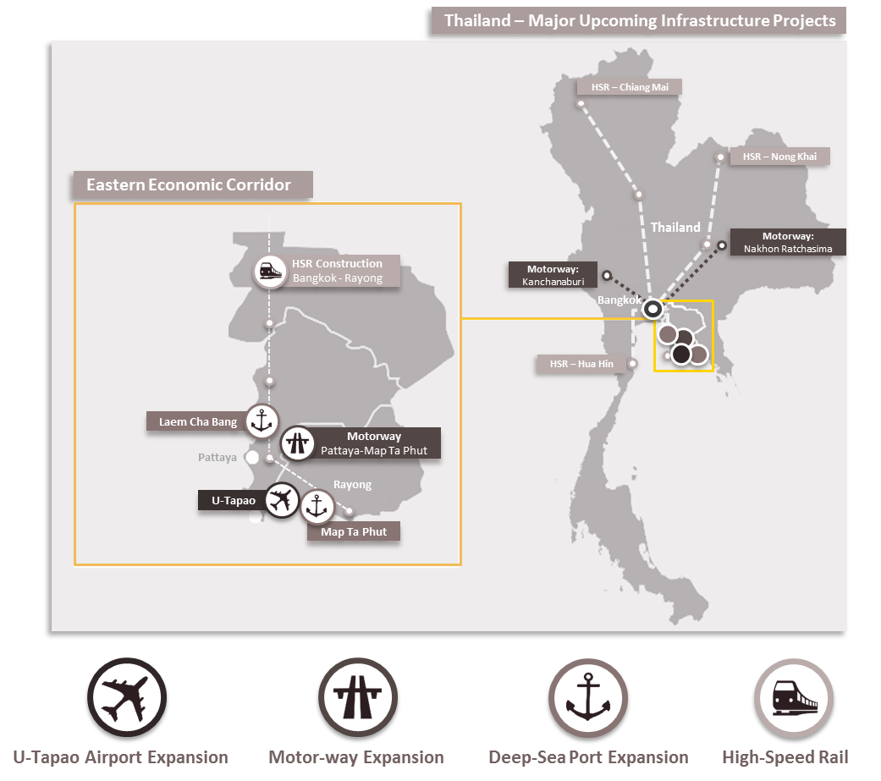
Financing Sustainable Urban Infrastructure
General Overview – Upcoming Infrastructure Projects
Thailand’s Focus – EEC Infrastructure
Development of the EEC aims to help revive investment in Thailand, and encourage dynamic technology transfer from foreign parties. To meet this goal, the Government will focus on three areas: Infrastructure Development Business Incentives Business Facilities Infrastructure development includes: Airport Expansion Motorway Extensions Deep-sea Port Upgrades Construction of new High-Speed Rail These developments will incentivize increased business in the region.
Source: EECO/KPMG Market Sounding

Slide 5
Financing Sustainable Urban Infrastructure
Upcoming EEC Infrastructure Project Development
Timeline of Major EEC Projects
The bidding processes and project development will be run in parallel; estimated completion by 2023 onwards.
EEC Timeline | Jun 18 | Jul 18 | Aug 18 | Sep 18 | Oct 18 | Nov 18 | Dec 18 | Jan 19 | Feb 19 | Commercial Operation
HSR Project Size: THB 247.1 bn. USD 7,603.1 mn. |  |  |  |  |  |  |  |  |  | 2024
U-Tapao Airport Phase I Project Size: THB 27.0 bn. USD 830.8 mn. |  |  |  |  |  |  |  |  |  | 2024
Map Ta Phut Port Phase III Project Size: THB 47.9 bn. USD 1,473.8 mn. |  |  |  |  |  |  |  |  |  | 2025
Laem Chabang Port Phase III Project Size: THB 45.0 bn. USD 1,384.6 mn.
Total Project Size: THB 367.0 bn. USD 11,292.3 mn.
RFP
Award to Bidders
RFP
Award to Bidders
RFP
Award to Bidders
RFP
2023
&
2027
Award to Bidders
Note: USD 1 = THB 32.5 Source: EEC website, HSR’s Market Sounding, Daily News, Info Quest, RFP, U-Tapao’s Market Sounding, Map Ta Phut’s Market sounding

Slide 6
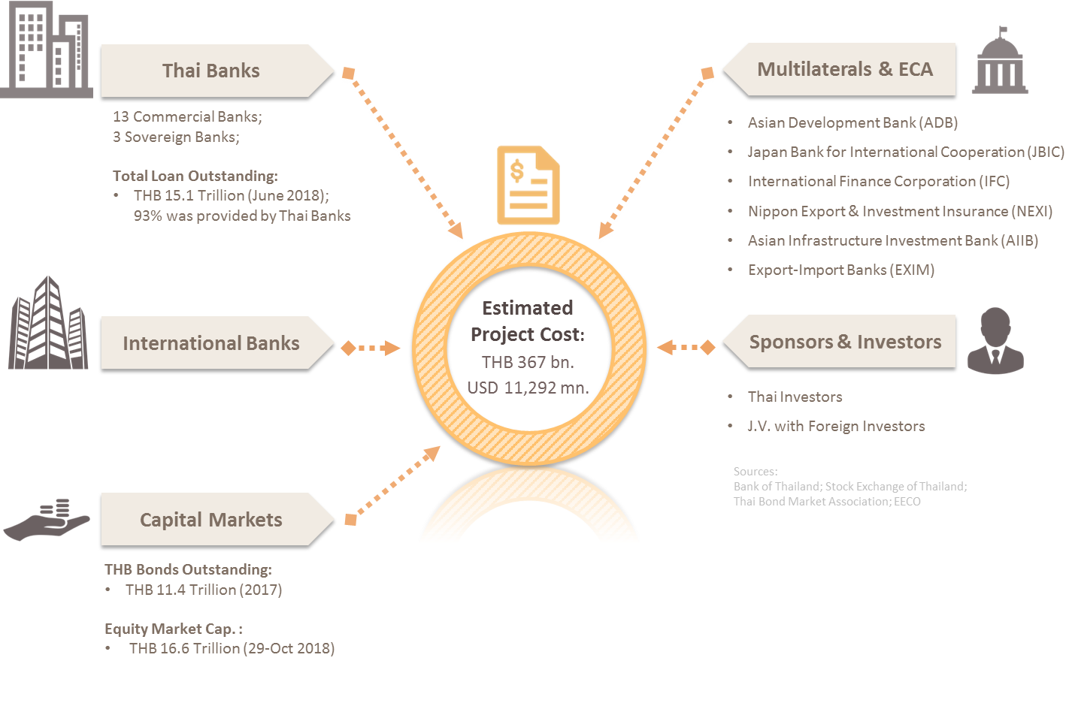
Financing Sustainable Urban Infrastructure
Upcoming EEC Infrastructure Project Development (2)
U-Tapao Airport Project – Analysis of Proposed Risk Allocation
Alternative Funding Sources

Slide 7
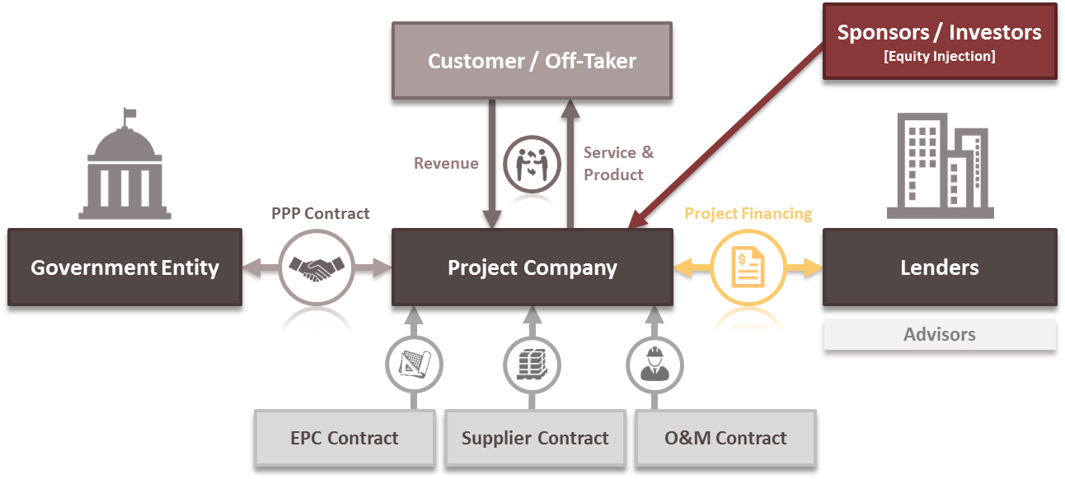
Financing Sustainable Urban Infrastructure
Typical Project Finance Structure
EPC – Engineering Procurement & Construction
O&M – Operation and Maintenance

Slide 8
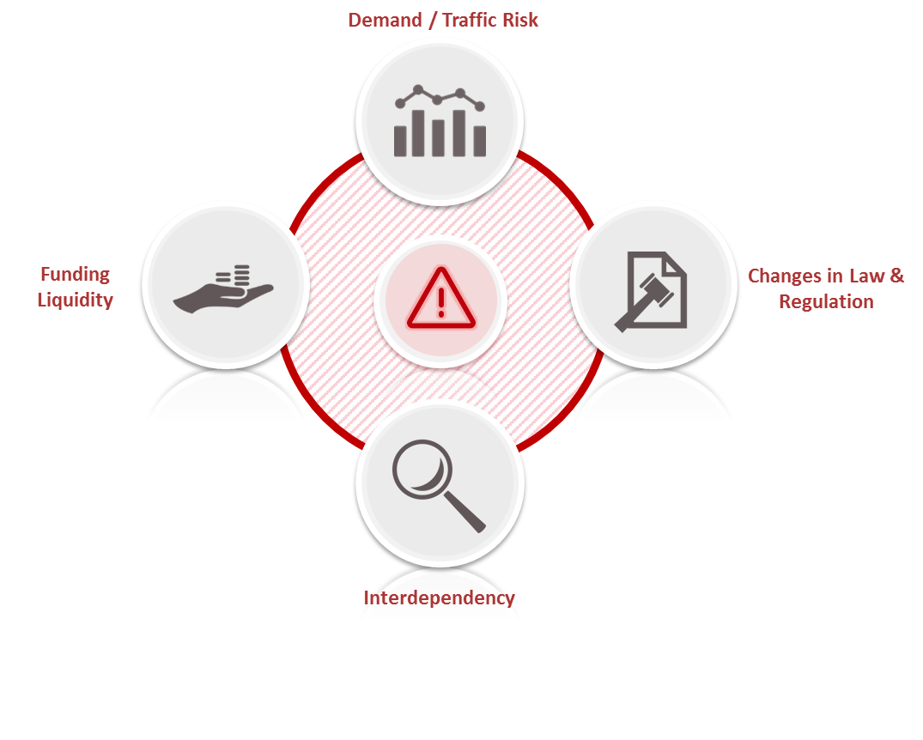
Financing Sustainable Urban Infrastructure
Key Challenges for Financing
U-Tapao Airport Project – Analysis of Proposed Risk Allocation
The success of the EEC projects are interdependent Assessment of Demand Risk / Traffic Changes in Law & Regulation Funding Liquidity

Slide 9
Financing Sustainable Urban Infrastructure
End of Presentation
U-Tapao Airport Project – Analysis of Proposed Risk Allocation
Disclaimer
This presentation has been prepared by Bank of Ayudhya Public Company Limited (the “Bank”) solely for informational purposes. It does not constitute an offer or sale or a solicitation of an offer to purchase securities, nor does it constitute a prospectus within the meaning of the Securities and Exchange Act B.E. 2535 of Thailand. Neither this presentation nor any part of it shall form the basis of, or be relied on in connection with, or act as an inducement to enter into, any contract or commitment whatsoever. No person should rely on the information contained in this presentation in making an investment decision in respect of any of the Bank’s securities. Any decision to purchase or subscribe for any securities of the Bank must be made on the basis of a thorough review of publicly available information of the Bank, including information made publicly available by the Bank pursuant to the requirements of the Securities Exchange of Thailand and the Thai Securities Exchange Commission. The information contained herein is only accurate as of its date. Copyright 2018 Bank of Ayudhya Public Company Limited. All rights reserved.

