Slide 1
Community health and achieving UN SDGs
via the development of a circular economy
within the organic agriculture industry
Urban October: 2018 Annual Session of Global Forum on Human Settlements
Circular Economy
By Spencer Leung

Slide 2
UN SDGs recap

Slide 3
Objective of business
Make profit
Earn money by creating values along the way
Every business needs to meet the needs of its clients
companies achieve this objective by creating useful products, providing services that generate savings for customers or by offering products or services that bring pleasure or ease pain.

Slide 4
Essence of a strong economy
“An economy is the system according to which the money, industry, and trade of a country or region are organized.”⁺
Rely on good relationship between
Society/People
Business/Private Sector
Government/Public Sector
+ Collins Dictionary

Slide 5
Linear vs Circular Economy
Grave yard

Slide 6
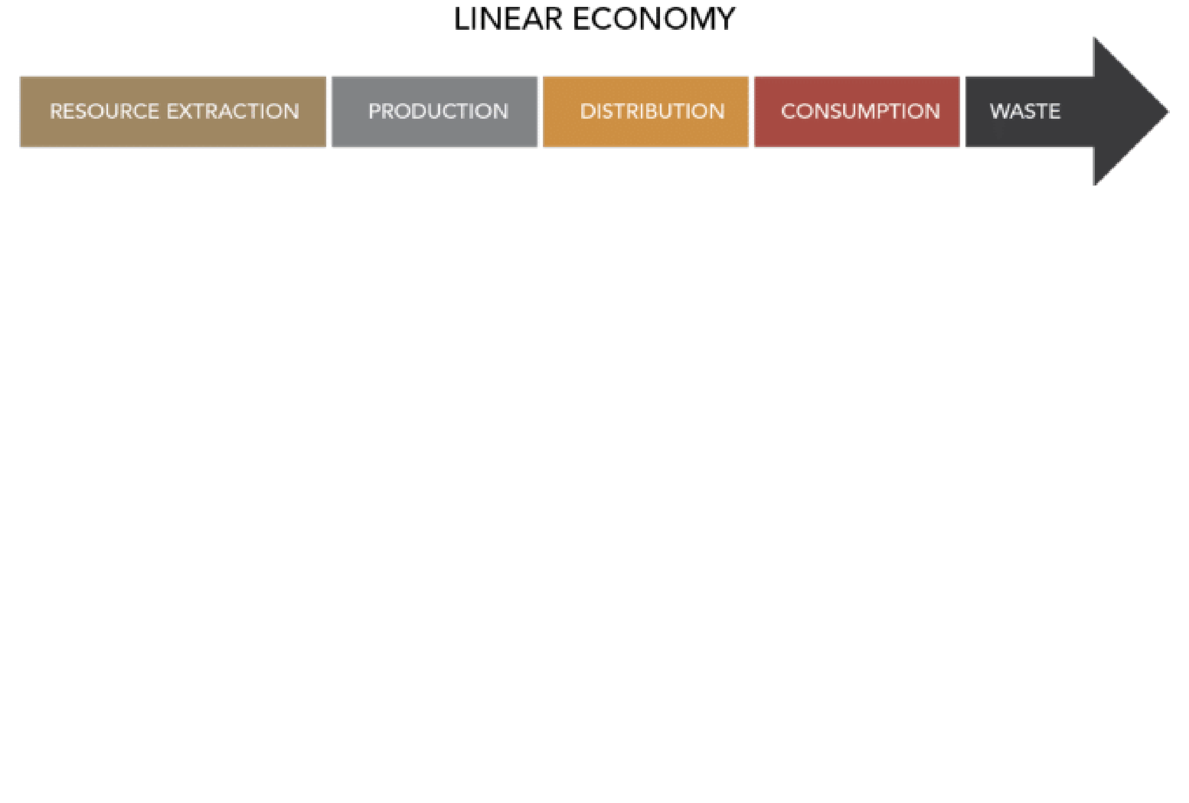
Conventional Farming – Linear Economy
Synthetic
Farm inputs
$$$
Dump
Landfill
Nutrition extraction
Plant grow
Harvest
Consumed
Food Waste

Slide 7
Organic Agriculture– Circular Process
"Organic Agriculture is a production system that sustains the health of soils, ecosystems and people.
It relies on ecological processes, biodiversity and cycles adapted to local conditions, rather than the use of inputs with adverse effects…”⁺
+ IFOAM Definition of organic agriculture

Slide 8
System Thinking – The Sustainability Compass⁺
+ Part of the AtKisson "Accelerator" suite of sustainability tools (http://atkisson.com)

Slide 9
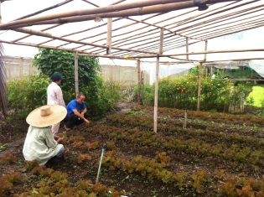
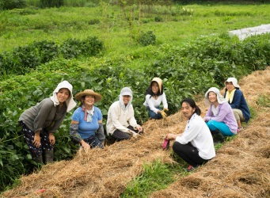
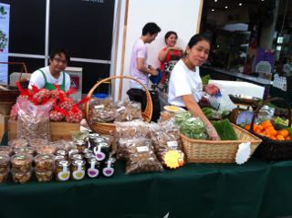
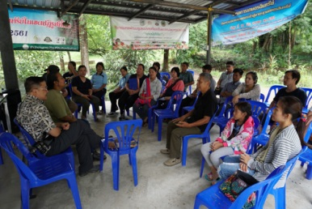
3-Dimensional Spherical Circular Movement of a socially inclusive organic industry
Working with nature on food production
Nature
Caring
Well-
being
Facilitate human
Interaction &
collaboration
Economy
Social
Aspect
Sustainable Econ. Dev.,
job creation, 3Rs
Communities & societies
Engagement (stakeholders)

Slide 10
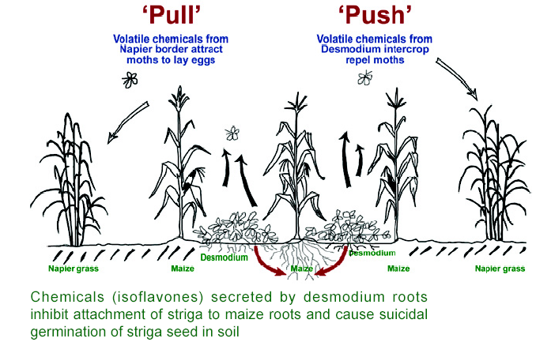
Nature - Circular Production Process in OA “Push – Pull” for Stemborer and Striga Control

Slide 11
Economy - Return Food Nutrition Back to the soil (zero-waste program)

Slide 12
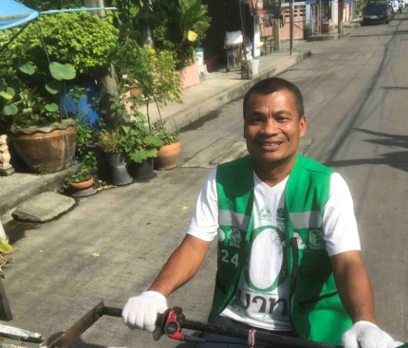
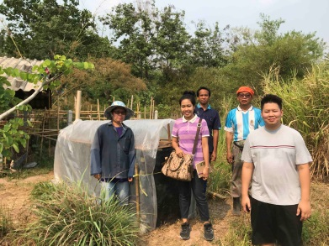
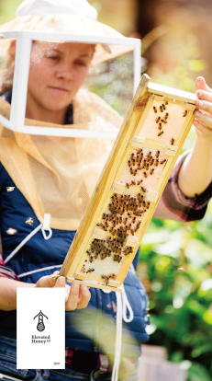
Society-Working with social enterprises for product/packaging design and knowledge sharing
Sustainable rice straw paper for packaging
Zero-baht Shop

Slide 13
Wellbeing = Inner Peace

Slide 14
Importance of a Circular Economy - water management

Slide 15
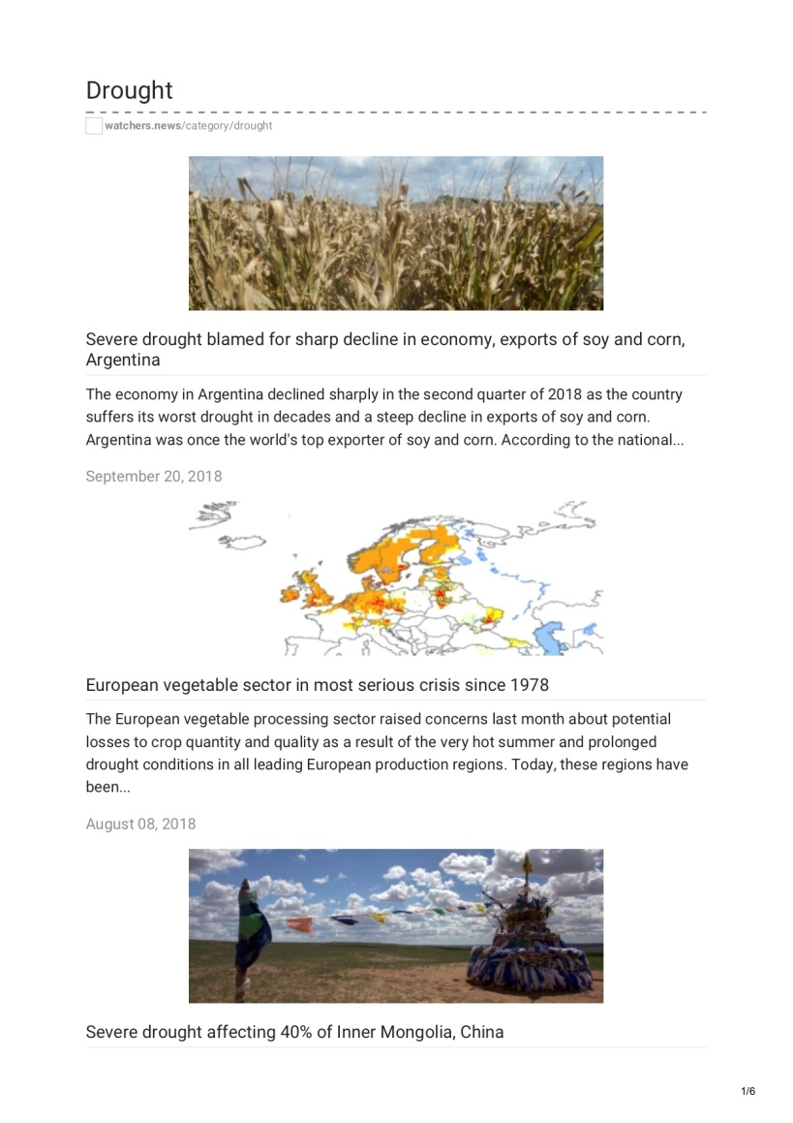
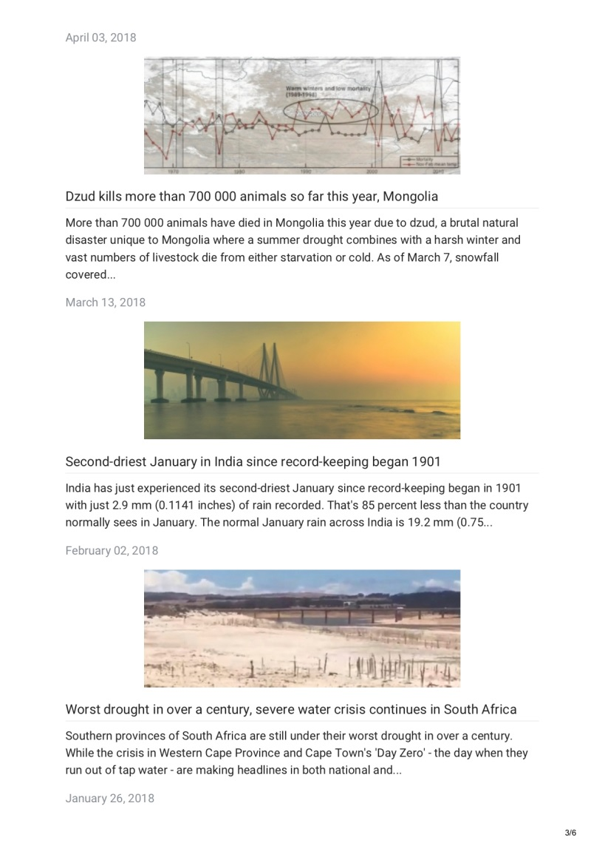
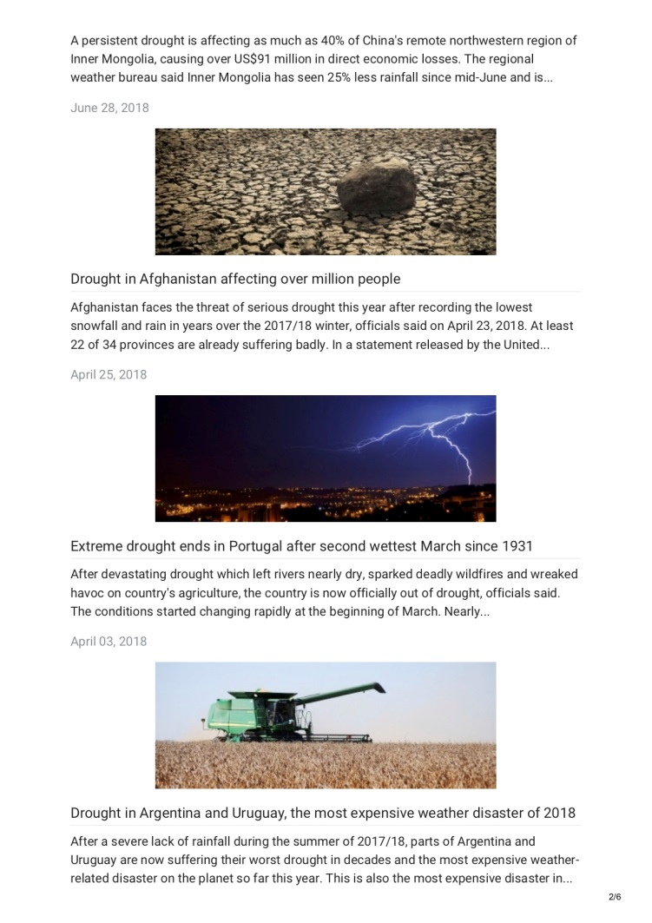
Drought - worldwide
https://watchers.news/category/drought/

Slide 16
Without a 3D perspective, all inclusive circular economy
How we can achieve sustainable economic development?
How can we achieve our Sustainable Development Goals?
How can peace be sustainable?
Good Read:
https://www.unescap.org/blog/circular-economy-making-sustainability-part-the-solution-asia-pacific

Slide 17
Empowering Regenerative Agriculture + Peace
Spencer Leung
m: +66 89 685 2808
e: spencer@goorganics.org
w: www.goorganics.org
l: https://th.linkedin.com/in/goorganics

