Slide 1
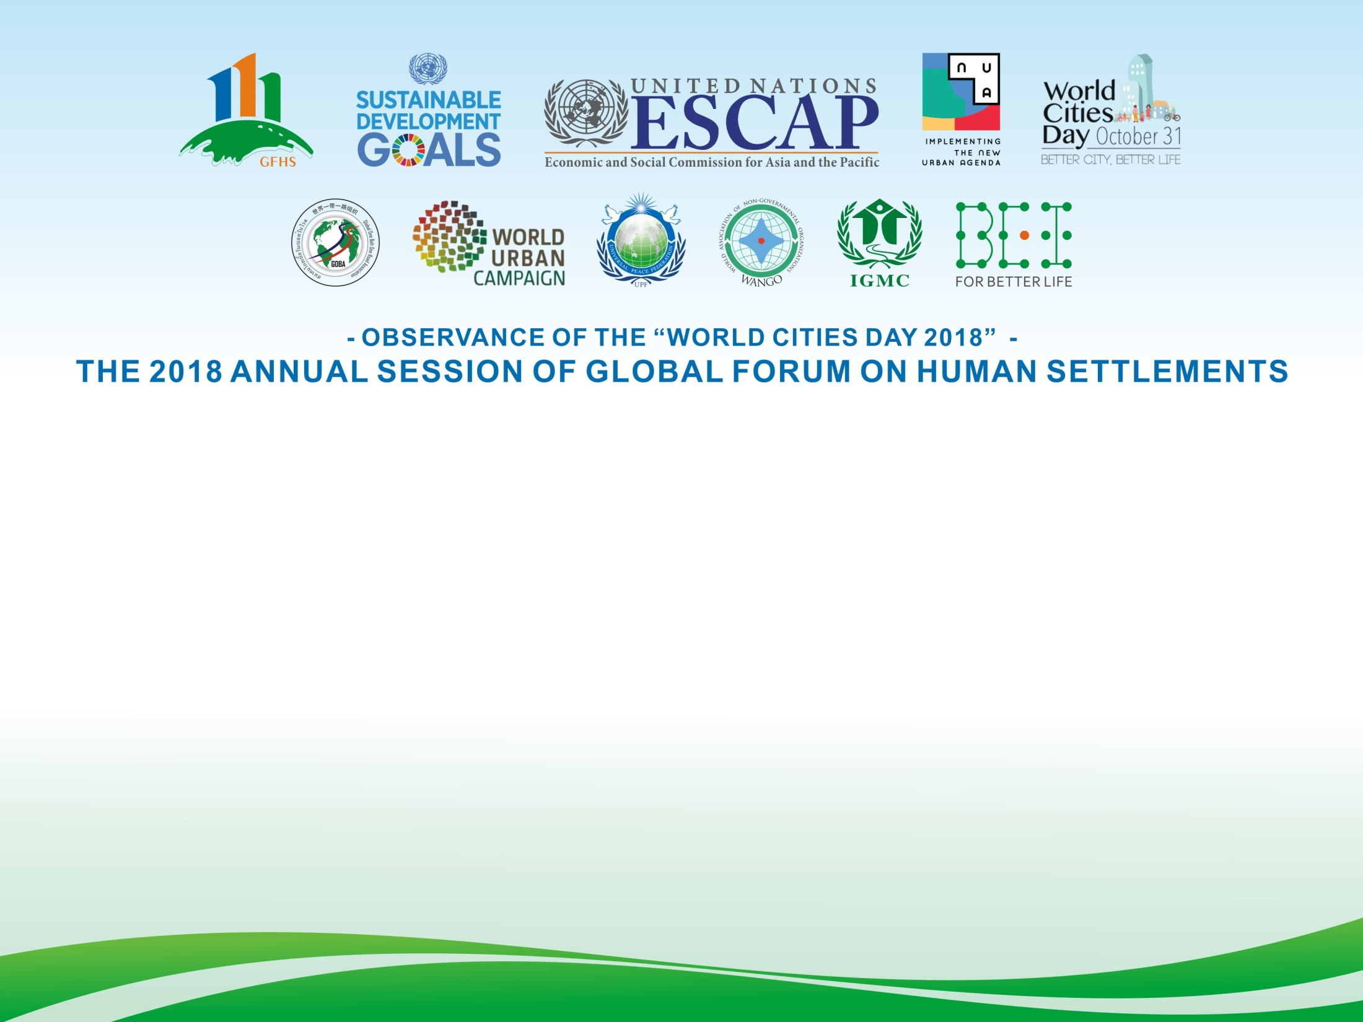
Rossawan Ponluksanapimol
Associate Director,
Head of Krungsri International Advisory,
JPC/MNC Banking, Bank of Ayudhya PCL.

Slide 2

Unblocking Water Scarcity Through Blockchain
Rossawan Ponluksanapimol, Ph.D.
Krungsri International Advisory
31 October 2018
The Annual Global Forum on Human Settlements, UNCC, Bangkok

Slide 3
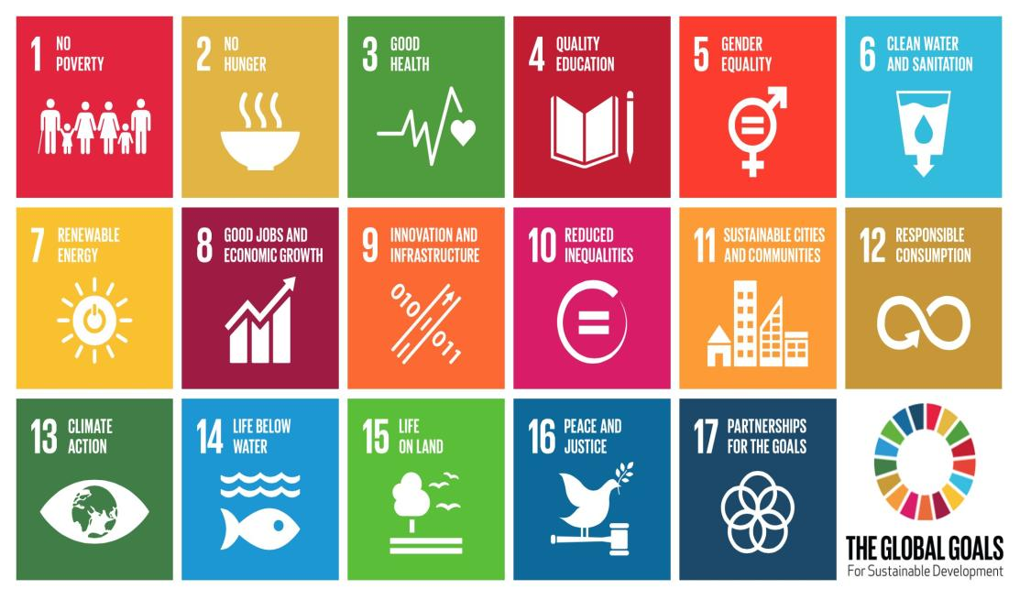
THE NEW PARADIGM FOR ACHIEVING SDG6
The UN’s development goals are heavily reliant on water equality
Source: Euromonitor International (2018)
3
Notes:
UN’s global sustainability goals #6 is specific to water, and most of them are heavily reliant on having “water equality”. The UN is particularly active in discussing water as a global issue; water, like territory, can be a significant motivator of conflict if a resolution for sharing cannot be found.

Slide 4
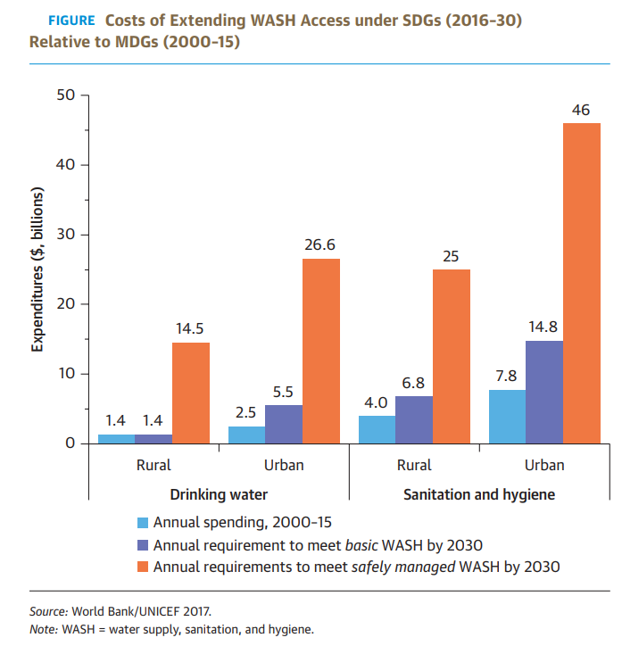
THE NEW PARADIGM FOR ACHIEVING SDG6
Costs of extending WASH access under SDGs (2016-30) relative to MDGs (2000-15)
Money flows where attention goes.
Attention is where the people are - Urban
Opportunities for stakeholders lie in “urban”
Investors rely on data for their investment
Sufficient Data increases confidence in investing
Data brings in Funding
Data and smart technologies must be embraced
More funding necessary to achieve water supply, sanitation, and hygiene
Opportunities for stakeholders (businesses, investors, and governments)
lie in “Urban”
Source: World Bank/UNICEF (2017), International Water Association (2018)
Note: WASH - water supply, sanitation, and hygiene
4
Notes:
Data and smart technologies must be embraced so interventions can be as effective as possible and progress tracked over time”.
As shown in the figure, SDG6 sets the performance bar higher than the millennium development goal 7 by addressing the reliability and quality of water services, which makes achieving water supply, sanitation, and hygiene (WASH) much harder. According to UN-Water’s SDG 6 Synthesis Report 2018 on Water and Sanitation, “The world is not on track to reach the SDG 6 on Water and Sanitation by the deadline set for 2030.”
In a rapidly changing world, we are still solving new problems with old solutions and our experience turns to be our worst enemy. Solving wicked water problems requires creativity and innovation to turn risks into opportunities, providing fit for purpose solutions, and changing the financing mechanisms of water, providing strong governmental leadership and accountability, as well as recognizing young water professionals as key stakeholders, acknowledging multiple knowledge cultures, and accepting the inevitability of uncertainty. The 2030 Agenda can only be realized with a strong commitment to partnerships at all levels and ensure leaving no one behind. As Dr. Mahmoud Mohieldin, World Bank’s Senior Vice President for the 2030 Development Agenda, United Nations Relations, and Partnerships, said: “Innovation work doesn’t happen in isolation, it requires a network of ideas, individuals, and institutions to come together to be more than a sum of their parts.”
It is very clear that the status quo is not enough to achieve the ‘water goal’ and bridge the financial gap in face of increasing demands and climate change. As shown in the figure, SDG6 sets the performance bar higher than the millennium development goal 7 by addressing the reliability and quality of water services, which makes achieving water supply, sanitation, and hygiene (WASH) much harder. According to (WHO and UNICEF 2017), 2.1 billion people lack access to safely managed drinking water services and 4.5 billion people lack safely managed sanitation services.
4

Slide 5

WATER on BLockchain
Case Studies – Blockchain Adoption in Canada and Australia
Blockchain is being trialled for data sharing, water trading, dam management, effluent monitoring and pollution control.
Remote sensing
Satellite imagery
Weather
AI and machine learning
Predictive modelling based on real time water quality
IoT
Nutrient flows
Pollutants
Flood
Using blockchain technology as the basis for data sharing improves security and authenticity, making data more accessible to communities, scientists and decision-makers, and creating an innovative framework for enhanced stakeholder engagement. This will likely trigger positive impacts in regional water governance by closing the gap on water information and data sharing between institutions. Open data directly increases entrepreneurial activity and improved business services.
Along with data sharing at a basin level, water markets are viewed as a key area of engagement by blockchain enthusiasts, eager to showcase how the technology could improve water governance. While many regions are investigating the technology, Australia’s clarity on blockchain regulations, combined with the maturity of its water market has fostered a high level of innovation. Civic Ledger, an Australian civic-focused blockchain company, created WaterLedger™ as a way to improve transparency of water trading in the country’s water markets. The system’s integration of over 15,000 complex business rules and real-time updates of state water registries was enabled by smart contracts.
Blockchain
Source: International Water Association (2018)
5
Notes:
An integration of open data with remote sensing, satellite imagery, IoT, AI and machine learning could allow predictive modelling based on real time water quality. Adding input data such as weather, nutrient flows and pollutants would help forecast water quality ahead of time in a river system as well as help companies assess their water risk. Beyond the business case for companies and water solutions providers, use cases of blockchain are being seen at the basin level.
Blockchain is being trialled for data sharing, water trading, dam management, effluent monitoring and pollution control. The open data movement is gaining traction internationally and enabling innovation by removing the cost barrier to information. Recently, Canada’s Gordon Foundation held an event to showcase their solution to the lack of open water data sharing across the country. While many groups collect water-quality datasets, until recently there was no common or secure place to openly share this data. The siloing of information has led to data deficiencies across the country, limiting the ability to monitor the impact of policies and govern effectively.
Using blockchain technology as the basis for data sharing improves security and authenticity, making data more accessible to communities, scientists and decision-makers, and creating an innovative framework for enhanced stakeholder engagement. This project will likely trigger positive impacts in regional water governance by closing the gap on water information and data sharing between institutions. Open data directly increases entrepreneurial activity and improved business services, so perhaps we will see a rise in water tech companies and water service in Eastern Canada as a result of these efforts.
Along with data sharing at a basin level, water markets are viewed as a key area of engagement by blockchain enthusiasts, eager to showcase how the technology could improve water governance. While many regions are investigating the technology, Australia’s clarity on blockchain regulations, combined with the maturity of its water market has fostered a high level of innovation. Civic Ledger, an Australian civic-focused blockchain company, created WaterLedger™ as a way to improve transparency of water trading in the country’s water markets. The system’s integration of over 15,000 complex business rules and real-time updates of state water registries was enabled by smart contracts.

Slide 6
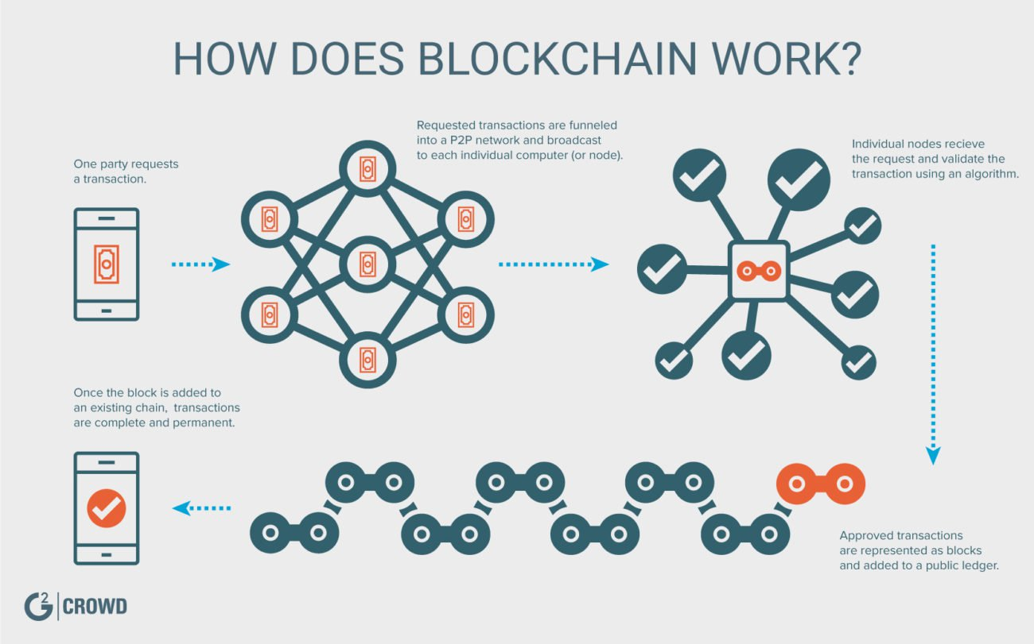
WATER on BLockchain
Blockchain Technology could ensure efficient use and distribution of water
Blockchain works as it stores data as “blocks” of information that are linked with other similar blocks of information, forming a chain. This chain of data blocks is part of why blockchain is considered to be so trustworthy – once the data is verified and recorded, it cannot be altered without also changing all the blocks around it.
Blockchain technology solved the challenge of having all devices on a network agree on validity when data is recorded, without allowing falsified or irrelevant inputs. This is done through computer programs called consensus protocols and these systems ensure that data kept in these decentralised ledgers are accurate and secure.
The shift of water utilities towards digital water technologies brings about exciting and paradigm shifting opportunities. The uptake of sensors and big data usage by utilities require data reliability, accessibility and analytics which can partly be managed via blockchain systems.
Digitising asset management can be made more reliable with this distributed ledger technology
Blockchain could ensure customer engagement and satisfaction, transparency and cost-effectiveness
Blockchain could increase the speed at which information is available to stakeholders.
Source: International Water Association (2018), G2 Crowd
6
Notes:
The Basics
The basics is this: “Blockchain is a decentralised record of information.” The potential applications of blockchain for the water sector are vast and could help to achieve the goal of an accessible, open source and open access way to share water data between public and private sector actors.
Very simply put, blockchain technology is a public ledger of information collected through a network that sits on top of the internet. The way in which this information is recorded is the exciting part, yielding a completely innovative way to document data online. Blockchain allows people who don’t know each other to trust a shared record of information.
The information is recorded via consensus, using confirmation from several nodes (for example computers). Imagine having several smart sensors monitoring water flow in a pipe. All devices record the same flow at a given time and record this data. With the blockchain, once the agreement has been reached between these devices about the flow, this information is stored and cannot be disputed or changed.
Along with the consensus and immutability of the information recorded, what makes blockchain unique is that it is not centralised in one principal database or ledger. Instead, many copies of the data are kept in different places on the network. Imagine printing multiple copies of a picture of yourself, tearing each copy into different pieces, and hiding them around your office. This ensures that if one piece of the picture is damaged, lost or your colleague draws a mustache on one image, then enough other copies around the office exist to show that in fact – you have no mustache in that picture. Similarly on the blockchain, if one piece of the record is changed without consensus from the rightful owners, there are multiple other copies of the record to prove that change false and obsolete.

Slide 7
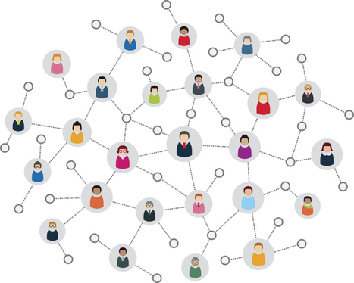


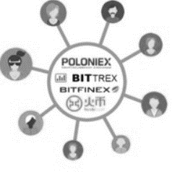
WATER on BLockchain
Decentralisation as a solution
New problems need new solutions. New solutions need feasibility and funding. For other world cities to follow the role model cities, unravelling water scarcity involves creativity and innovation to turn risks into opportunities, providing fit for purpose solutions, smart data technologies, and changing the financing mechanisms of water.
Centralised
Decentralised
Traditional Funding
Crowdfunding
PPP
Project Finance
Transaction Banking
Change the way we manage water today, shifting from centralized solutions to decentralized solutions, reducing and managing the high level of non-revenue water, transforming our perspective from a linear ‘use and dispose’ approach to a more sustainable circular economy model, attaching values to the resources and harnessing the water, energy and food nexus in the entire water system especially wastewater.
Innovative solutions such as crowd funding schemes with enabling environment could be a game changer in creating fit for purpose solutions to financial challenges and empowering young water professionals and innovators in partnership with local government, private sectors, and research groups.
Source: World Bank (2018), International Water Association (2018), European Commission (2018)
7
Notes:
Public utilities and governments are typically unable to meet development finance demands solely through public resources and have to attract new sources of financing. Unlocking private sector capital for development projects that aim at providing safe and affordable water and sanitation services to the poor is particularly challenging due to uncertaintainties in return on investment and limited regulatory framework to ensure the democratic ownership, effectiveness and accountability. This is where innovative solutions are needed. These financial obstacles can be translated into opportunities at local level in which crowd funding schemes with enabling environment can be a game changer in creating fit for purpose solutions to financial challenges and empowering young water professionals and innovators in partnership with local government, private sectors, and research groups.
We must think differently about water to ensure food security, conserve delicate ecosystems and end poverty by 2030. This paradigm shift can be achieved by changing the way we manage water today, shifting from centralized solutions to decentralized solutions, reducing and managing the high level of non-revenue water, transforming our perspective from a linear ‘use and dispose’ approach to a more sustainable circular economy model, attaching values to the resources and harnessing the water, energy and food nexus in the entire water system especially wastewater (World Bank, 2018). In addition to investment, technological exchange is a core requirement for successful implementation of the SDG6 to transfer the affordable, scalable solutions that are available and it can therefore increase collaboration between regions and provide a sustainable boost to both developing and developed economies.
Achieving the SDG6 relies not only on setting goals, but also on a responsive approach to the voice and needs of local communities and young water professionals.
By engaging youth in decision-making, empowering and equipping them with skills, knowledge and confidence in their abilities, there is a real chance that global leaders can harness the potential of youth to reach the SDGs by 2030.
Crowdfunding can come any form of:
Peer-to-peer lending
Equity crowdfunding
Rewards-based crowdfunding
Donation-based crowdfunding
Profit-sharing/ revenue-sharing
Debt-securities crowdfunding

Slide 8






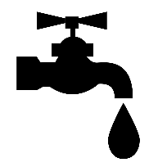
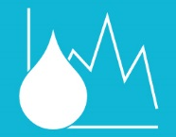
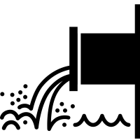
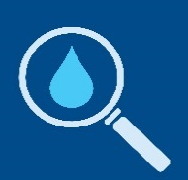
WATER on BLockchain
Water data flow on blockchain
Three levels of blockchain for water managment
The first level is the storing of digital records in a controlled, secure, auditable and immutable way, not simply of transactions but also of digital representations of physical assets – for example, a utility’s water quality data, rainwater amount, amount of recycled wastewater, etc.
The second level is the exchange of digital assets where people can transfer ownership in real time – for example, water bill payment. This can help mediate payments between producer and consumer, as well as record exact exchanges of water resource assets and payments through new digital financial systems like cryptocurrencies
The third level is the execution of smart contracts which are contracts written in code that include rules, conditions, expiry dates and any other necessary information that are embedded in a blockchain and automatically execute when the conditions are met.
Source: International Water Association (2018)
8
Notes:
There are three levels of blockchain.
The first level is the storing of digital records in a controlled, secure, auditable and immutable way, not simply of transactions but also of digital representations of physical assets – for example a utility’s water quality data.
The second level is the exchange of digital assets where people can transfer ownership in real time without the need for banks, stock exchanges or payment processors – for example paying for a water bill. Water utilities face acute challenges at a local scale to meet the needs of growing urban populations. Costly centralised systems might not be the way forward and if (or when) the predicted trend towards decentralisation and digitalisation becomes a reality, then blockchain technology will be fundamental to this new digital water world.
Some creative and innovative projects are being facilitated through blockchain. Blockchain technology can help mediate payments between producer and consumer, as well as record exact exchanges of water resource assets and payments through new digital financial systems like cryptocurrencies. This technology has the potential to decentralise and democratise the use and management of resources and put communities at the centre of sustainable development.
The third level is the execution of smart contracts which are contracts written in code that include rules, conditions, expiry dates and any other necessary information that are embedded in a blockchain and automatically execute when the conditions are met.
Smart contracts allow businesses to reduce the time spent on paperwork, enforcing contracts and interacting with third parties. The terms of the smart contract are recorded into the code and subsequently implemented automatically through the shared network which monitors compliance and verifies the outcomes without the need of a third party – for example, payments to contractors wherein a smart contract would be possible for contractors only if it determines the business has enough funds to pay for the requested services. Another example of the use of blockchain-based smart contracts is the trade of water rights in water markets – this will be discussed in more detail in the blog on blockchain for basins.

Slide 9



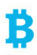

WATER on BLockchain
Smart Contracts
Smart contracts are simply programs that run and are executed on the blockchain. The smart contract defines the conditions under which the parties have agreed to and once these conditions are met, certain actions are executed. These programmed applications can be used for simple cases like escrow payments, which could be useful in insurance claims, water markets, or pay-by-results financing*. A new generation of businesses and opportunities are emerging, built on this technology and pushing beyond simple cases to more complicated systems that involve tokenisation, prediction markets, and even smart impact bonds.
How a smart contract works
*A pay-by-results smart contract in WASH programmes
In pay-by-results models, robust budgeting for monitoring and evaluation is required and reporting takes on a significant role to ensure that quality evidence of impact is presented. Innovative ways to structure contracts include payments for achieving specific outcomes and these payment milestones need to be agreed upon based on clearly defined and unambiguous indicators. A smart contract could be designed for funds to be released once impact data is verified by monitors and evaluators, be they human, machine or a combination. Once the data is verified (if this), payments would be automatically released to the project implementers and leaving behind a transparent and auditable ledger of information.
Match Distributer with Recipient
Exchange Contracts:
Contract receives assets
Contract distributes assets
Source: International Water Association (2018)
9
Notes:
The success of Blockchain Technology triggered the development of new capabilities and the rise of smart contracts heralded the second generation of blockchain technology. Smart contracts are simply programs that run and are executed on the blockchain. The smart contract defines the conditions under which the parties have agreed to and once these conditions are met, certain actions are executed. These programmed applications can be used for simple cases like escrow payments, which could be useful in insurance claims, water markets, or pay-by-results financing. A new generation of businesses and opportunities are emerging, built on this technology and pushing beyond simple cases to more complicated systems that involve tokenisation, prediction markets, and even smart impact bonds.
A pay-by-results smart contract in WASH programmes
In pay-by-results models, robust budgeting for monitoring and evaluation is required and reporting takes on a significant role to ensure that quality evidence of impact is presented. Innovative ways to structure contracts include payments for achieving specific outcomes and these payment milestones need to be agreed upon based on clearly defined and unambiguous indicators. A smart contract could be designed for funds to be released once impact data is verified by monitors and evaluators, be they human, machine or a combination. Once the data is verified (if this), payments would be automatically released to the project implementers (then that), without delays and leaving behind a transparent and auditable ledger of information.

Slide 10
KEY MESSAGE
Collaboration is needed in both supply and demand sides, at both governmental and human levels
Boost Awareness and good practices
Improve household understanding of better sanitation
Develop education and awareness campaigns
subsidise poor household sanitation expenditures
Disclosure of information on negative environmental and health impacts of bad sanitation
Develop and finance targeted subsidies for low sanitation households
Develop and support facilities that enable payment on installment terms
Ensure funding
Political Prioritisation
Functioning Legal Framework
Transparency in Water Cycle Management
Source: United Nations and Asian Institute of Technology (AIT) 2015
10
Notes:
We must ensure funding, functioning legal framework, and transparent governance of water and sanitation services as a top priority.

Slide 11
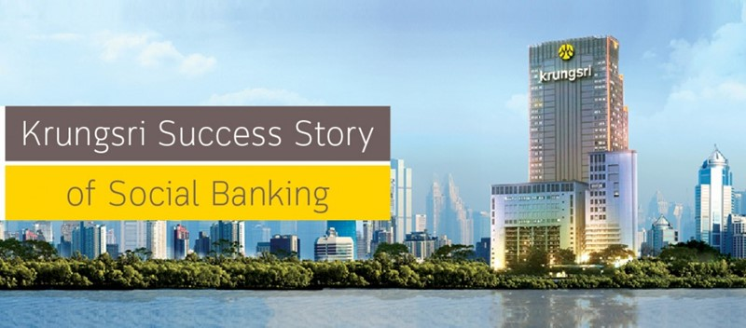
Disclaimer
This presentation has been prepared by Bank of Ayudhya Public Company Limited (the “Bank”) solely for informational purposes. It does not constitute an offer or sale or a solicitation of an offer to purchase securities, nor does it constitute a prospectus within the meaning of the Securities and Exchange Act B.E. 2535 of Thailand. Neither this presentation nor any part of it shall form the basis of, or be relied on in connection with, or act as an inducement to enter into, any contract or commitment whatsoever. No person should rely on the information contained in this presentation in making an investment decision in respect of any of the Bank’s securities. Any decision to purchase or subscribe for any securities of the Bank must be made on the basis of a thorough review of publicly available information of the Bank, including information made publicly available by the Bank pursuant to the requirements of the Securities Exchange of Thailand and the Thai Securities Exchange Commission. The information contained herein is only accurate as of its date. Copyright 2018 Bank of Ayudhya Public Company Limited. All rights reserved.
11
Notes:
UN’s global sustainability goals #6 is specific to water, and most of them are heavily reliant on having “water equality”. The UN is particularly active in discussing water as a global issue; water, like territory, can be a significant motivator of conflict if a resolution for sharing cannot be found.

Slide 12
Appendices

Slide 13

INTRODUCTION TO WATER SCARCITY
A world of water scarcity in numbers
29%
Proportion of the earth’s surface as land
80%
Of developing nations discharge untreated human and livestock waste into ground water supplies
3.5%
Human withdrawal of fresh water from total land-based precipitation, remainder going to the water table, run-off and rivers flowing back into the ocean
2,025 litres
Of water is embedded inside a 150g beef steak vs 30 litres embedded inside the same weight of vegetables
50%
Of the human population will be living in “water stress” by 2030 (demand exceeding supply, reducing the water table). This gets even worse from 2040
21%
Of drinking quality water is leaking from pipes across Europe and Asia
Source: Euromonitor International (2018)
13
Notes:
Poor sanitation and wastewater management in developing countries leads to the contamination of fresh water sources and is a major cause of disease and death and affects also the health of eco-systems. 80 percent of all wastewater generated in developing countries is discharged directly into surface water bodies without any treatment.
13

Slide 14
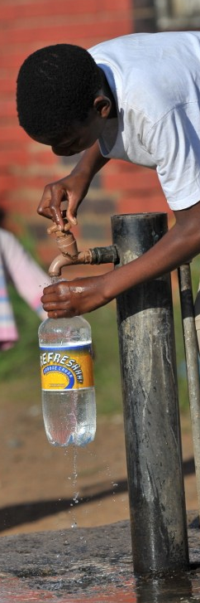
INTRODUCTION TO WATER SCARCITY
Water scarcity and new sources of water
Physical scarcity versus economic scarcity | The African continent and especially the Middle East region suffer from extreme physical water scarcity across large portions of inhabited land. These regions withdraw large portions of precipitation from their ground water for human use, and the vast majority is needed for food production, placing strains on economic growth and needed infrastructures for societal progress and new technologies. India, on the other hand, has economic scarcity - it is one of the most water-affluent nations on earth with high levels of rainfall, but a lack of investment in infrastructure means enormous amounts of that water are lost, either to pollution or through leaks that remove more than 30% of the supply from the system. Physical scarcity needs a focus on new sources of water, but economic scarcity needs better water management policy and investment to solve the issue. The worst affected areas of economic scarcity show no signs of such change.
Three water psychologies | Large portions of the world live in a mindset of “abundance”, never giving consideration to water as a finite resource, taking for granted an endless and cheap supply. A water shock lies ahead for these people - scarcity will affect us all. The psychology of “crisis” hits during a water shortage and throws all assumptions and priorities in the air. Once this settles back to normality, it moves to “compromise” with water as more important.
There is no magic bullet solution yet | Desalination is the best technology so far, and even this falls short of solving the problem. Not only public sectors, but private sectors can also improve quality of life for consumers in a water crisis, and have a duty to do more about water scarcity.
Source: Euromonitor International (2018)
14
Notes:
14

Slide 15
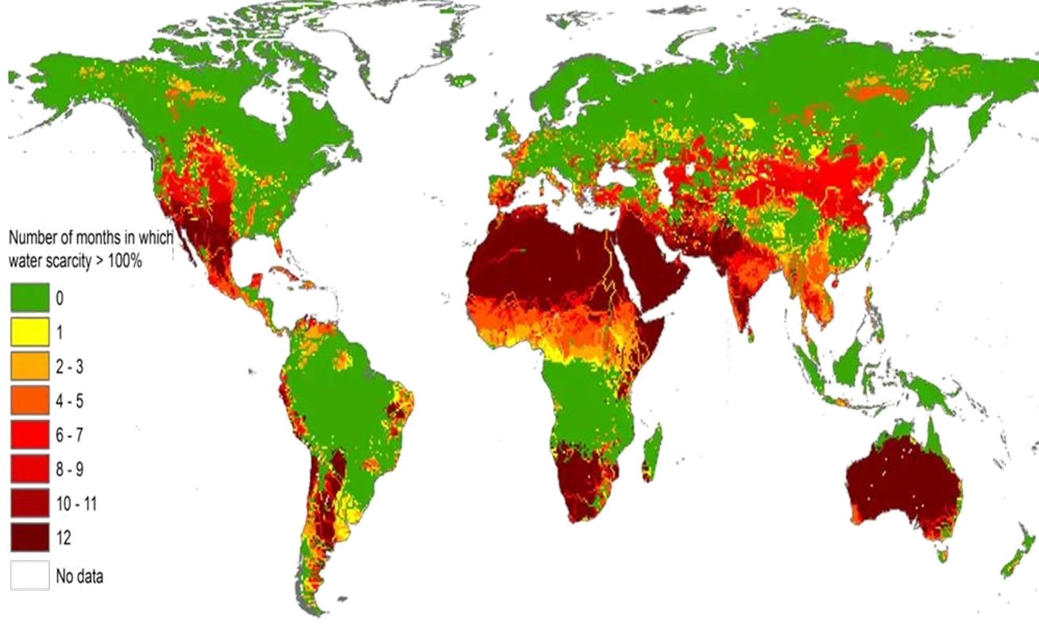
INTRODUCTION TO WATER SCARCITY
Water scarcity by region and the current “hot spots” for shortages
Source: Euromonitor International (2018)
15
Notes:
The UN projects half of the world’s population will be living in areas of continual water stress by 2030, due to climate change and depleted underground aquifers.
15

Slide 16
APPENDIX - Accounts and data
The Hydrological Cycle
Source: ESCAP
16
Notes:
In a rapidly changing world, we are still solving new problems with old solutions and our experience turns to be our worst enemy. Solving wicked water problems requires creativity and innovation to turn risks into opportunities, providing fit for purpose solutions, and changing the financing mechanisms of water, providing strong governmental leadership and accountability, as well as recognizing young water professionals as key stakeholders, acknowledging multiple knowledge cultures, and accepting the inevitability of uncertainty. The 2030 Agenda can only be realized with a strong commitment to partnerships at all levels and ensure leaving no one behind.

Slide 17
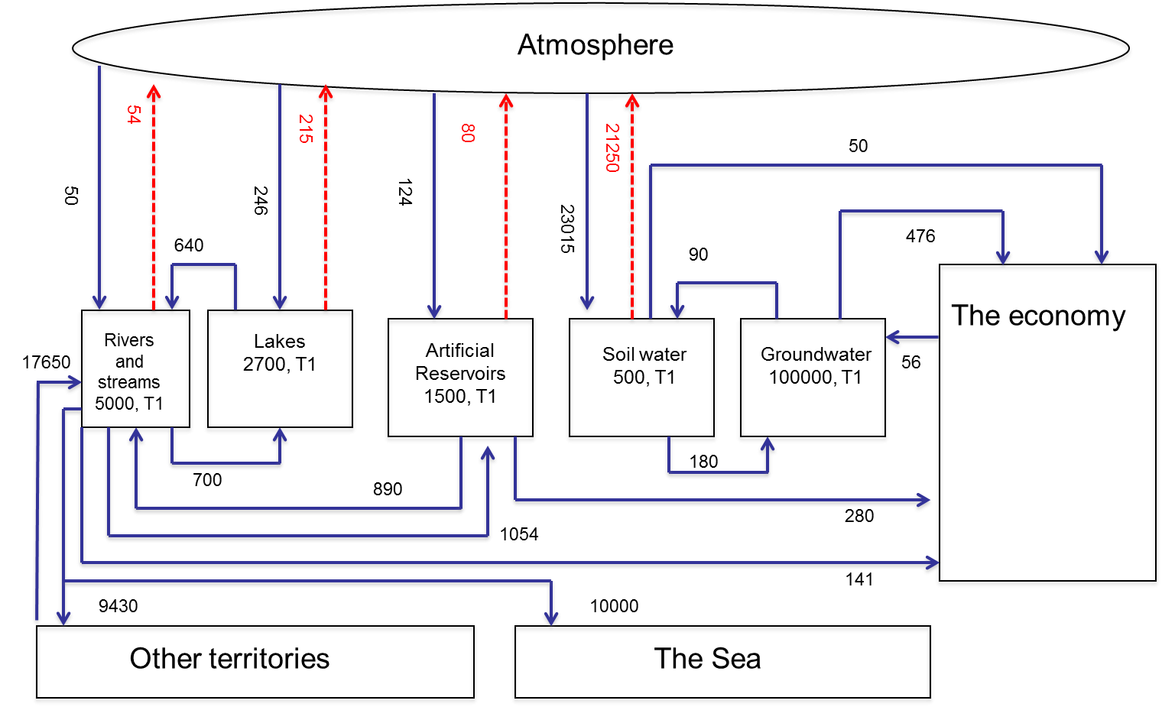
APPENDIX - Accounts and data
Water Asset Account
Accounts provide a framework for arranging data. They enable data from different sources to be integrated. They also enable gaps and deficiencies in primary data sources to be identified and addressed.
Data are needed to provide information not just about water quantity, both on the surface and underground, but also about its quality, social and economic relations as well as environmental dimensions.
Source: ESCAP, World Water Forum (5th)
17
Notes:
In a rapidly changing world, we are still solving new problems with old solutions and our experience turns to be our worst enemy. Solving wicked water problems requires creativity and innovation to turn risks into opportunities, providing fit for purpose solutions, and changing the financing mechanisms of water, providing strong governmental leadership and accountability, as well as recognizing young water professionals as key stakeholders, acknowledging multiple knowledge cultures, and accepting the inevitability of uncertainty. The 2030 Agenda can only be realized with a strong commitment to partnerships at all levels and ensure leaving no one behind.

Slide 18
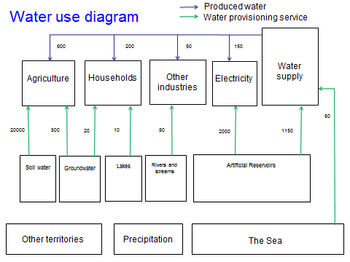
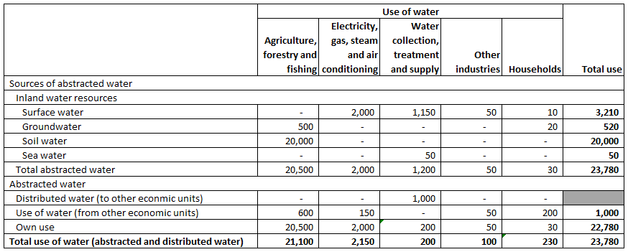
APPENDIX - Accounts and data
Water Use Account
On the water use accounting side, companies that are required to disclose their financial information can keep this data on an immutable public ledger that is timestamped and thus decrease the need for manual auditing to determine authenticity. This level of transparency can be applied across the water sector to reduce fraud and corruption. In water utilities, immutable and secure blockchain systems can help overburdened organisations save countless hours of manual work.
Source: ESCAP, IWA
18
Notes:
In a rapidly changing world, we are still solving new problems with old solutions and our experience turns to be our worst enemy. Solving wicked water problems requires creativity and innovation to turn risks into opportunities, providing fit for purpose solutions, and changing the financing mechanisms of water, providing strong governmental leadership and accountability, as well as recognizing young water professionals as key stakeholders, acknowledging multiple knowledge cultures, and accepting the inevitability of uncertainty. The 2030 Agenda can only be realized with a strong commitment to partnerships at all levels and ensure leaving no one behind.

Slide 19
APPENDIX - WATER on BLockchain
Blockchain Use Cases
Evidence-based decision making requires data around the quality, quantity, allocation, risks and use of water. Missing data, the high cost of maintaining information, and lack of access to data by important stakeholders all contribute to limiting our collective ability to achieve the high level aims of the SDGs and beyond.
A simple use of the blockchain would be for record keeping of water quality data along a catchment area. In situations where data is collected by multiple groups like communities, scientists, enterprises, research institutions and environmental monitoring agencies, blockchain can be used to provide an immutable record of data collected by all parties inputting information into the same decentralised, distributed, open source and open access system. As well, a blockchain ledger would allow for better tracking of updates to information for scientists that are benchmarking and tracking changes over time. Blockchains are already being used to create transparent supply chains and this could be translated into the water sector for catchment to tap water quality mapping.
Whether a catchment has smart sensors that automatically upload the data to the blockchain or whether the data is uploaded by basin authorities or citizen scientists, a decentralised ledger allows public and private sector stakeholders to cost effectively access and utilise the information. The HLPW recommends making evidence-based decisions about water, and cooperating to strengthen water data. Integrating new technologies like blockchain will be necessary to achieve this ambitious global framework and establish a foundation for valuing water.
Smart contracts allow businesses to reduce the time spent on paperwork, enforcing contracts and interacting with third parties. The terms of the smart contract are recorded into the code and subsequently implemented automatically through the shared network which monitors compliance and verifies the outcomes without the need of a third party – for example, payments to contractors wherein a smart contract would be possible for contractors only if it determines the business has enough funds to pay for the requested services. Another example of the use of blockchain-based smart contracts is the trade of water rights in water markets
Source: International Water Association (2018)
19
Notes:
Evidence-based decision making requires data around the quality, quantity, allocation, risks and use of water. Missing data, the high cost of maintaining information, and lack of access to data by important stakeholders all contribute to limiting our collective ability to achieve the high level aims of the SDGs and beyond.
A simple use of the blockchain would be for record keeping of water quality data along a catchment area. In situations where data is collected by multiple groups like communities, scientists, enterprises, research institutions and environmental monitoring agencies, blockchain can be used to provide an immutable record of data collected by all parties inputting information into the same decentralised, distributed, open source and open access system. As well, a blockchain ledger would allow for better tracking of updates to information for scientists that are benchmarking and tracking changes over time. Blockchains are already being used to create transparent supply chains and this could be translated into the water sector for catchment to tap water quality mapping.
Whether a catchment has smart sensors that automatically upload the data to the blockchain or whether the data is uploaded by basin authorities or citizen scientists, a decentralised ledger allows public and private sector stakeholders to cost effectively access and utilise the information. The HLPW recommends making evidence-based decisions about water, and cooperating to strengthen water data. Integrating new technologies like blockchain will be necessary to achieve this ambitious global framework and establish a foundation for valuing water.

Slide 20
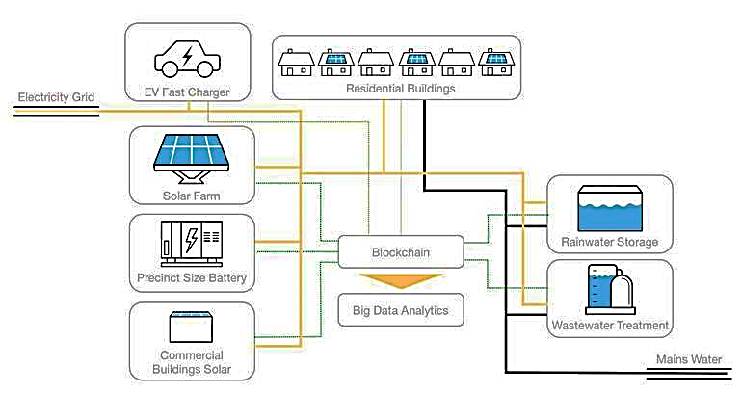
APPENDIX - WATER on BLockchain
Case Study 2 : Water management in Singapore
City Of Fremantle Water Blockchain Project (Australia)
Singapore’s treated salt water and treated used water that recovers back to drinking grade is set to increase over time to 85% with its NEWater programme based on membrane filtration and ultraviolet disinfection.
Fremantle City (Australia) trials the use of blockchain under a project hoping to assess how cities can use the technology, alongside data analytics, to integrate distributed energy and water systems.
Source: Euromonitor International (2018)
Source: https://www.zdnet.com/
20
Notes:
Singapore:
45% of the treated city water is used by domestic homes (although farming is taking an ever-increasing portion as city agriculture expands, adding more water pressure).
Demand for water is expected to double between 2016 and 2060 due to population and economic growth levels.
Singapore already has one of the largest proportions globally of water coming from treated salt water and treated used water recovered back to drinking grade (65%), and this is set to increase over time (to 85%) with its NEWater programme based on membrane filtration and ultraviolet disinfection.
The barriers are frequently economic, not physical capability.
20

Slide 21
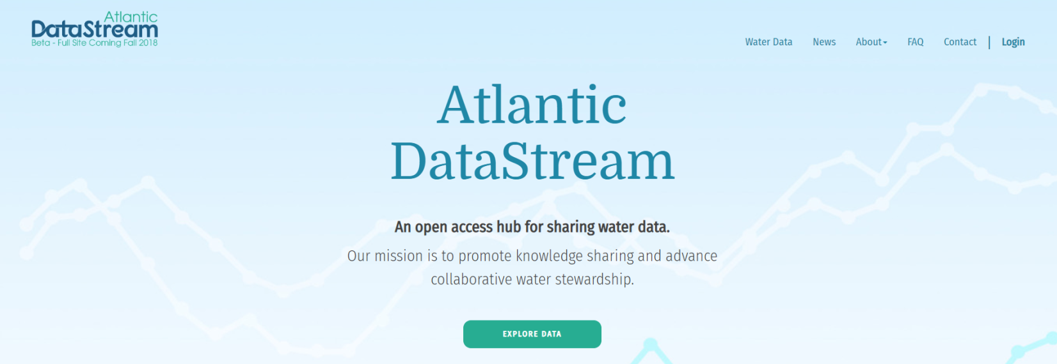
APPENDIX - WATER on BLockchain
Case Study 3: Adoption in Atlantic Datastream, WaterLedgerTM
Tangible projects like the Atlantic Datastream, WaterLedger™, and others are key to wider adoption of blockchain technology in the water sector. Beyond smart contracts, the emerging generation of blockchain projects and businesses are tangibly linking the digital and physical worlds in ways that incentivise good governance, value data, improve financing and liquidity for SDGs and empower citizens. Achieving SDG6 will reshape the global economy, create new opportunities for humankind, and will require investments at a global scale. With blockchain technology’s ability to incentivise actions, its application to SDG6 projects can become an innovative way to increase funding for water and create more transparency for investors. Through the use of digital economic incentives (cryptoassets, tokenisation and cryptoeconomics), new blockchain initiatives are enabling individual rewards for a common good and creating ways to avoid the tragedy of the commons as it relates to water. This game changing technology has the potential to not only support better water governance, but also to scale how impact in the water sector is achieved and funded.
Source: International Water Association (2018), https://atlanticdatastream.ca
21
Notes:
Tangible projects like the Atlantic Datastream, WaterLedger™, and others are key to wider adoption of blockchain technology in the water sector. Beyond smart contracts, the emerging generation of blockchain projects and businesses are tangibly linking the digital and physical worlds in ways that incentivise good governance, value data, improve financing and liquidity for SDGs and empower citizens. Achieving SDG6 will reshape the global economy, create new opportunities for humankind, and will require investments at a global scale. With blockchain technology’s ability to incentivise actions, its application to SDG6 projects can become an innovative way to increase funding for water and create more transparency for investors. Through the use of digital economic incentives (cryptoassets, tokenisation and cryptoeconomics), new blockchain initiatives are enabling individual rewards for a common good and creating ways to avoid the tragedy of the commons as it relates to water. This game changing technology has the potential to not only support better water governance, but also to scale how impact in the water sector is achieved and funded.

Slide 22
APPENDIX - WATER on BLockchain
Case Study 4 - Government Subsidy in Canada
1. The Capacity Buyback Programme
Open to commercial and institutional organizations, the Program offers a free water audit and one-time cash rebate. The Capacity Buyback program encourages and rewards commercial and institutional organizations by:
  offering a free water audit to help identify ways to reduce water use
  rewarding participants that implement permanent water-saving measures with a one-time cash rebate of up to 30 cents per litre of water saved per average day
  helping participants save money over the long-term with reduced water bills
2. Industrial Water Rate Program
Open to industrial water customers, the Industrial Water Rate offers a discounted water rate (called the Block 2 rate) to manufacturers that implement a water conservation plan
3. Sewer Surcharge Rebate Program
Open to industrial, commercial and institutional water customers, the Program offers a rebate on water not discharged into the sanitary sewer system (i.e. water evaporated from cooling towers or used to make a product)
Source: https://www.toronto.ca
22
Notes:
For water utilities that are incorporating an ever expanding menu of digital water technologies, secure blockchain systems diminish risks of hacking, data destruction and improve transparency. The shift of water utilities towards digital water technologies brings about exciting and paradigm shifting opportunities. The uptake of sensors and big data usage by utilities require data reliability, accessibility and analytics which can partly be managed via blockchain systems. Digitising asset management can be made more reliable with this distributed ledger technology. Finally, as a way to ensure customer engagement and satisfaction, transparency and cost-effectiveness are crucial to building strong relationships with clients. Open data systems can help set up a basis for trustworthy utilities and blockchain can increase the speed at which information is available to stakeholders.
The most successful water utilities will be those where the underlying blockchain systems are invisible to users in seamless, user friendly ways and integrated across digital water technologies. Blockchain is the final drop in the wave of digital water disruption. The technology enables businesses to remove intermediaries that have long been embedded in the cost and resourcing of operations. This will fundamentally alter the way we interact with transactions and the way we manage and operate access to assets like water.

