Slide 1

Matthew Ulterino
Property Investment Project Coordinator
UNEP Finance Initiative

Slide 2
Channeling Private Finance for low-carbon and sustainable cities
Global Forum for Human Settlements
October 31, 2018

Slide 3
Private Finance and Sustainable Cities
Overview
Drivers for green / sustainable investments
  Disclosure and benchmarking
  Sustainable Development Goals (SDGs)
  New finance opportunities
Public sector action for increasing finance flows
  Policy setting, coherence
  Standards and regulations
  Own-source revenue

Slide 4
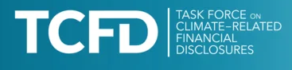
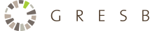
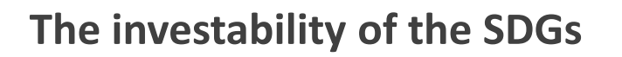
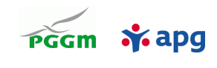

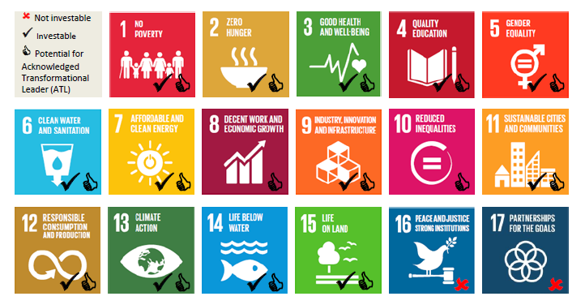
Private Finance and Sustainable Cities
Drivers
Attention on financial disclosures and benchmarking
Closing the SDG finance gap
https://www.fsb-tcfd.org/ and http://www.unepfi.org/climate-change/tcfd/ ttps://api.gresb.com/infra/home
https://www.pggm.nl/english/what-we-do/Documents/SDI-taxonomies-APG-PGGM-mei_2017.pdf
https://www.unpri.org/download?ac=5426 http://www.unepfi.org/positive-impact/positive-impact/

Slide 5
Private Finance and Sustainable Cities
Drivers
Green Bond Principles (ICMA): eligible Green Project categories:
  Renewable energy & energy efficiency
  Pollution prevention and control
  Agriculture, aquaculture, viticulture
  Biodiversity conservation
  Clean transportation
  Circular economy / clean production
  Green buildings
  Water, wastewater management
ASEAN Green Bond Standards (ASEAN Capital Markets Forum) – specific guidance for regional issuers

Slide 6

Private Finance and Sustainable Cities
Drivers
Evolving technologies and finance structures
“Distributed energy technologies such as battery storage, onsite generation and energy efficiency can deliver an 11% CO₂ saving across the healthcare, industry and hospitality sectors by 2030” (Centrica, Oct 2018)
Source: Taurus Investment Holdings / Ecosmart Solutions

Slide 7
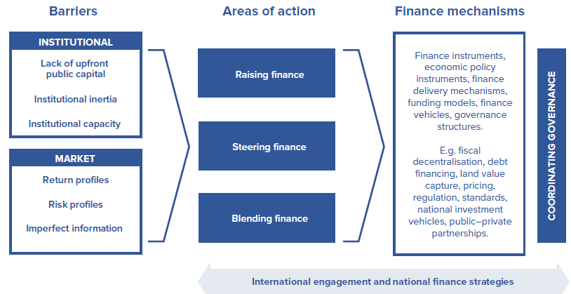
Private Finance and Sustainable Cities
Public sector actions
National govt. role in financing sustainable urban infrastructure
Source: Coalition for Urban Transitions - Global Review of Finance For Sustainable Urban Infrastructure

Slide 8
Private Finance and Sustainable Cities
Public sector actions
2018 Global Investor Statement to Governments on Climate Change (319 investors /USD $28 trillion in assets)
Excerpts:
Update and strengthen NDCs and focus on implementation
Formulate and communicate long-term emission reduction strategies
Put a meaningful price on carbon, phase out fossil fuel subsidies
Commit to implement the TCFD recommendations
Source: Global Investor Coalition on Climate Change

Slide 9
Private Finance and Sustainable Cities
Public sector actions
S&P Global Ratings
Through The ESG Lens: How Environmental, Social, And Governance Factors Are Incorporated Into U.S. Public Finance Ratings
Pompano Beach FL: credit rating upgrade due in part to disaster planning, efforts to address sustainability, climate change, and sea level rise in its long-term planning efforts, development regulations, and infrastructure improvements.
Rockport, TX: downgraded in the aftermath of Hurricane Harvey from potential tax-base deterioration, and uncertainty on budgetary performance and flexibility following the hurricane

Slide 10
Private Finance and Sustainable Cities
Public sector actions
Importance of key national transport policy instruments
N = 77
Source: Coalition for Urban Transitions - Identifying national policies to enable compact, connected and coordinated urban development (forthcoming)

Slide 11

Thank you
Matthew Ulterino
Property Investment Project Coordinator
UNEP Finance Initiative
matthew.ulterino@un.org
Tel: +1 (585) 417-0615 (US)
Tel: +44 (0)20 8133 8620 (UK)
www.unepfi.org | www.unep.org
Facebook | Twitter | LinkedIn | YouTube

